Slide 1
How to free half of the money tied up in stock – without running out
CASE STUDY · INVENTORY MANAGEMENT AND OPTIMISATION · HSLU
The project explained step by step, for someone who has not seen the details
Notes:
Welcome. This deck tells the story of the inventory project from start to finish. Imagine we are consultants and the company is our client. The client has one big worry: too much money is sitting in the warehouse. Our job was to find out where that money is, why it is there, and how to reduce it without the company running out of goods. The headline result: the money tied up in stock can fall by about 55 percent, and in our test the share of demand served straight from the shelf actually goes up, from 74 to 90 percent. Every slide answers the question raised by the slide before it.

Slide 2
A Swiss business-to-business company with a full warehouse
THE CLIENT
About 80 people
100,000 articles
Makes and buys
Procurement decides
A Swiss company selling to other businesses, not to private consumers.
A very large product range. 1,751 of them are deliberately kept in the warehouse.
Some products are made in-house from parts; others are bought in and resold.
The purchasing team maintains the data and sets when each article is reordered.
During Covid-19 and the supply chain problems, the company stocked up on purpose so it would not run out. That worked – but it tied up a lot of money.
Notes:
Who is the client? A business-to-business company in Switzerland with about 80 employees and around 100,000 articles. Some articles are parts that the company uses in its own production to build products. Some are finished products the company makes itself. Others are bought in from suppliers and simply resold – we call those retail or bought-in articles. The purchasing department (procurement) maintains the article data and decides when an article is reordered. Of the 100,000 articles, only 1,751 are kept on the shelf on purpose; the rest are ordered when needed. Important background: during Covid-19 and the supply chain crisis, suppliers were unreliable, so the company deliberately bought more than usual to avoid running out. That protected availability, but it tied up a lot of money in the warehouse. That money is the client's problem.

Slide 3
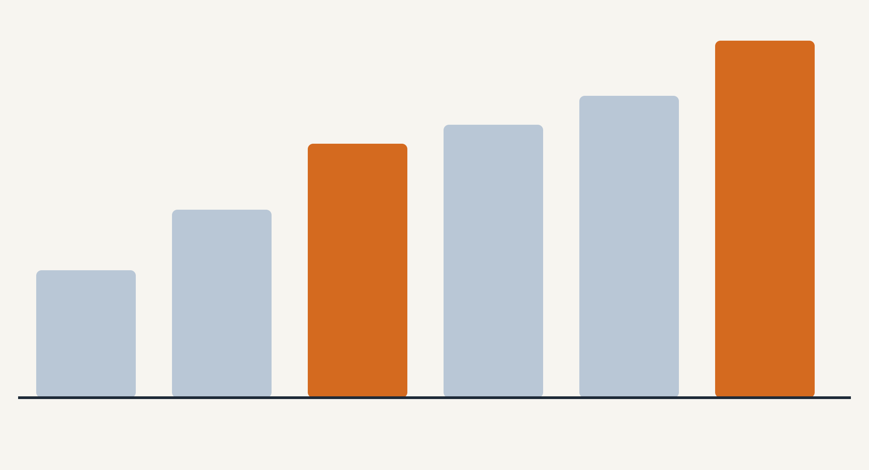
The problem: money piling up on shelves
THE PROBLEM
4.9
+41%
4.2
3.8
3.5
more money tied up in stock from 2018 to 2021
2.6
128 → 136 days
1.8
how long the stock would last at the normal rate of use
Stock grew faster than sales and use.
2016
2017
2018
2019
2020
2021
Money tied up in stock, million (disguised units)
Notes:
This is the client's problem in one picture. The bars show the money tied up in stock each year, for today's 1,751 stock articles. 'Money tied up in stock' (the course calls it capital lockup) is simply: the average number of units on the shelf multiplied by the purchase price. It is money that sits on a shelf instead of in the bank. From 2018 to 2021 it grew by 41 percent. Is that bad? Only if it grew faster than the business. We have no revenue data, so we compare with how much the company actually consumed (sold plus used in production). We express that as 'days of coverage': if nothing new arrived, how many days would the stock last? It went from 128 to 136 days, so stock grew faster than consumption. Two small honesty notes: the data are disguised (anonymised), so the numbers are not real francs – we talk in percentages. And earlier years look smaller partly because we only count articles that are stock articles today.

Slide 4
The client's three questions
OUR APPROACH
1
2
3
Where is the money?
Which articles belong on the shelf?
How much should we keep of the rest?
What we did: analysed 15 years of stock movements.
What we did: sorted the articles into groups of similar ones.
What we did: calculated new reorder points and tested them on 2021.
Short answer: in a few active articles – because too much is ordered at once.
Short answer: four groups, each with its own rule.
Short answer: about half the money, with better availability.
Notes:
We turned the client's worry into three simple questions, and the whole project follows them. Question 1: where is the money actually sitting? We answered it with data analysis of 15 years of stock movements. Question 2: which articles should be on the shelf at all? Not every article needs to be stocked – some can be ordered or produced only when a customer asks. We answered it by sorting the articles into groups of similar articles (the course calls this article classification; technically it is clustering). Question 3: for the articles that stay on the shelf, how much should we keep? We answered it by calculating new reorder points and safety stocks and testing them on the real demand of 2021. Keep these three questions in mind; every following slide belongs to one of them.

Slide 5
Eight words you need for this project
WORDS WE USE
Stock article
Money tied up
Demand
Lead time
An article the company keeps on the shelf on purpose. There are 1,751.
Average stock × purchase price. Money on the shelf instead of in the bank.
What customers buy plus what our own production uses.
Days between placing an order and the goods arriving.
Reorder point
Safety stock
Minimum order
Availability
The stock level at which we place a new order.
Extra buffer for surprises while we wait for a delivery.
The smallest amount a supplier sells in one order.
Share of demand we can serve straight from the shelf.
Notes:
Before we go on, here are the eight words the whole project is built on. Stock article: an article the company deliberately keeps in the warehouse; in the data these are the articles whose safety stock field is above zero – 1,751 of them. Money tied up (capital lockup): average stock times purchase price. Demand: what customers buy plus what our own production uses; customer returns are subtracted. Lead time: the number of days between placing an order with a supplier and the goods arriving. Reorder point: the stock level that triggers a new order. Safety stock: an extra buffer that protects us if demand during the waiting time is higher than usual. Minimum order quantity: the smallest amount a supplier is willing to sell in one order. Availability (the technical name is fill rate): the share of all demand that we can serve immediately from the shelf; 90 percent means 9 out of 10 units requested were there. One trap: in this company's system, the field called 'safety stock' is actually used as the reorder point. We treat it that way throughout.

Slide 6
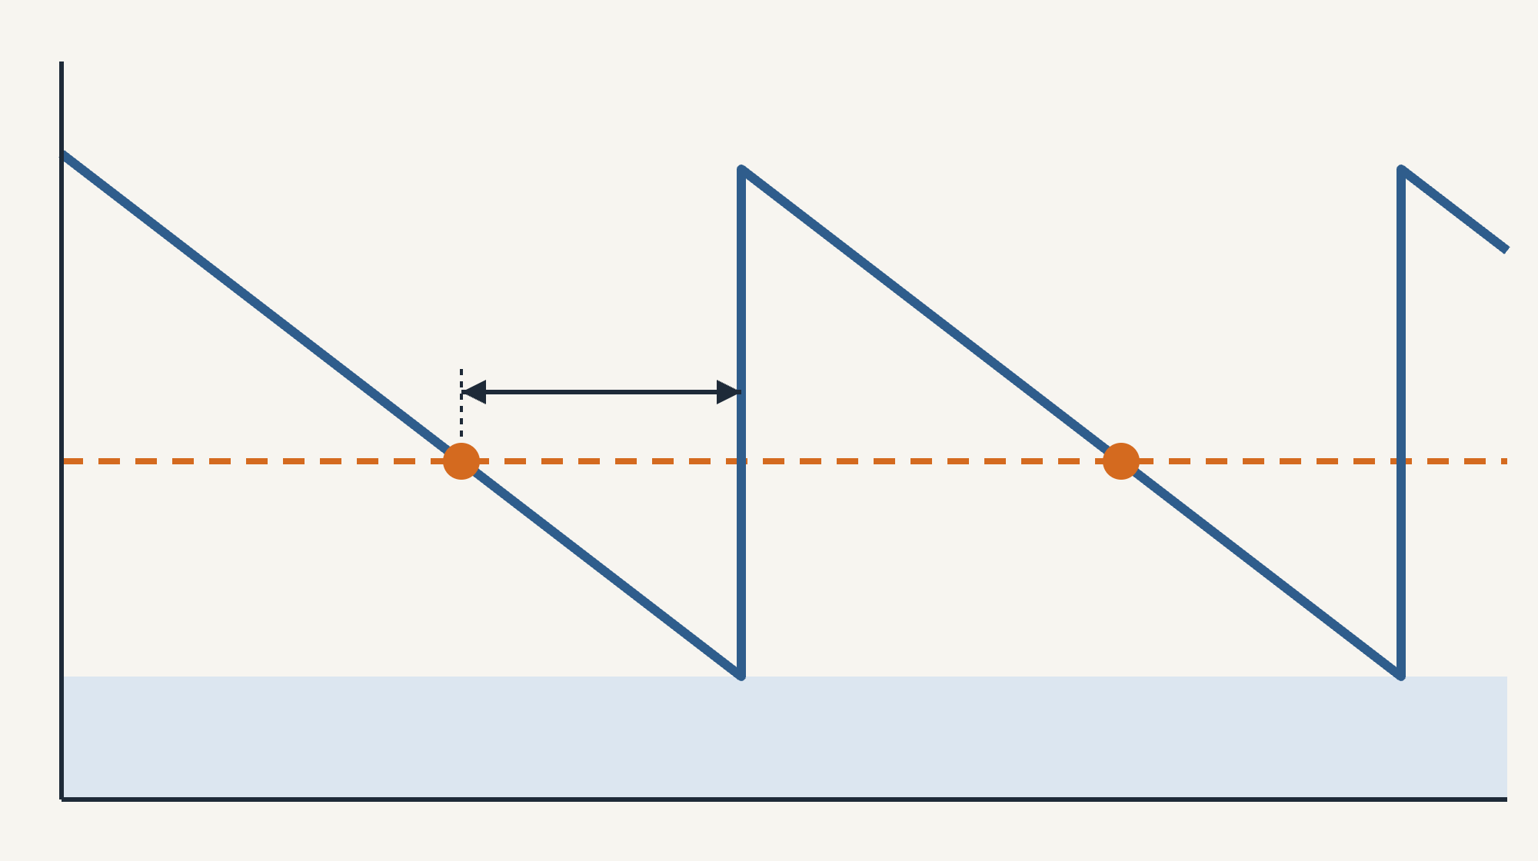
How a warehouse decides when to reorder
BASICS
Stock on the shelf ↑
Every day stock goes down, because we sell or use it (blue line).
When it reaches the reorder point, we place an order (orange dot).
The order needs some days to arrive – the lead time. Meanwhile stock keeps falling.
The safety stock is a small extra cushion in case demand during the wait is higher than usual.
The delivery arrives and stock jumps up by the order size.
Delivery arrives
Lead time (waiting)
Reorder point
Safety stock (buffer)
time →
Notes:
This slide is the most important background for everything that follows, so let us go slowly. The blue line is the number of units on the shelf over time. It goes down every day, because customers buy and production uses the article. The orange dashed line is the reorder point. The moment stock touches it – the orange dot – the purchasing team places an order. But the goods do not arrive immediately; the supplier needs some days. That waiting time is the lead time, shown by the black arrow. During the wait, stock keeps falling. If everything goes as expected, the delivery arrives just as stock reaches the light blue band at the bottom. That band is the safety stock: a cushion in case demand during the wait is higher than normal or the delivery is late. When the delivery arrives, stock jumps up by the order quantity, and the cycle starts again. Two consequences matter for our project. First, the reorder point should equal the demand expected during the lead time plus the safety stock. Second, how high the stock goes after each delivery depends on how much you order at once. Big orders mean a lot of stock on average, no matter how good the reorder point is. Average stock is roughly the safety stock plus half of one order.

Slide 7
What we worked with
STEP 1 · WHERE IS THE MONEY?
2,694,849
15 years
1,751
Disguised
stock movements: every sale, purchase, use and correction
from January 2007 to January 2022
stock articles, out of 58,764 articles in the data
prices and quantities, so we speak in percentages
How we prepared the data, in plain words
Demand = sales + use in our own production. Customer returns are subtracted.
We end the data on 21 January 2022, where normal activity stops.
We removed only true one-off spikes; repeated big customer orders are real and stay in.
The stock history has a data glitch: we calculated it two ways – the conclusions are the same.
Notes:
Our raw material: one big file with 2,694,849 rows. Each row is one stock movement – a sale, a purchase, a use in production, a correction – with the date, the article, the quantity, the stock level and the article's master data (price, lead time, reorder point, minimum order, product groups). It covers 15 years. The prices and quantities were disguised before we got them, so only relative numbers are meaningful. Cleaning decisions, in plain words. One: demand is what customers buy plus what our production uses; returns count against it. Purchases and receipts from production are supply, not demand. Internal transfers between locations add up to almost zero, so they are ignored. Two: after 21 January 2022 there are only a few odd monthly bookings, so we stop the data there. Three: we only removed real one-off errors – an order more than ten times the article's usual size with nothing similar ever again. Repeated big orders, such as several orders of 26,000 to 56,000 units of one article, are genuine business-to-business demand and stayed in. Four: the stock level jumps between days in about half the cases, probably because of how bookings are dated or how the data were disguised. We rebuilt the stock a second way from the quantities: yearly totals differ by only 5 to 13 percent and the trends are identical, so the conclusions do not depend on it. We used the method that gives the lower, more cautious number.

Slide 8
Where the money sits: in a few active articles
STEP 1 · WHERE IS THE MONEY?
74%
5%
49%
of the money sits in just 10% of the stock articles – about 175 articles.
of the money is in “dead” articles that nobody bought or used for over a year.
is in parts for our own production; 36% in bought-in sales articles; 12% in own-made finished products.
So: the savings must come from articles that are moving – they simply hold too much.
Notes:
First answer to question 1. The money is very concentrated: 10 percent of the stock articles, about 175 articles, hold 74 percent of the money. Even the top 1 percent, 18 articles, hold 31 percent. That is good news, because it means a few decisions have a big effect. Second: many people expect the problem to be old 'dead' stock that nobody buys any more. That is not the case here. Articles without any sale or use for more than a year hold only about 5 percent of the money; 95 percent sits in articles that moved within the last year. Third: the data do not say whether an article is a production part, a finished product or a bought-in article, but the stock movements reveal it. If an article is received from our own production, it is a finished product. If it is mainly used up in production, it is a production part (the course calls it semi-finished). Otherwise it is a bought-in sales article (retail). Production parts hold 49 percent of the money, bought-in sales articles 36 percent, own-made finished products 12 percent. Conclusion: we cannot save much by throwing out dead stock. The savings must come from active articles that simply hold too much.

Slide 9
The problem is not when the company orders – it is how much it orders at once.
THE KEY INSIGHT
57%
74%
of the money on the shelf is not needed even by the company's own reorder points.
availability when we replay 2021 with today's reorder points: many of them are actually too low.
The company bought availability with money: big orders and large minimum orders filled the shelves – and hid the low reorder points.
Notes:
This is the heart of the story, so take your time here. We took the company's own current reorder points and replayed the year 2021 with them, but ordering sensible amounts each time (one month of demand, or the supplier's minimum if that is larger). With that discipline, the shelves would have held 1.78 million units of money. In reality the same articles held 4.10 million. So 57 percent of the money on the shelf is not needed even by the company's own rules – it comes from ordering much more at once than necessary: bulk purchases during Covid, and suppliers' minimum order quantities that cover months or even years of demand. For 281 articles, a single minimum order covers more than a year of demand. The second number is the surprise: in that same replay, the current reorder points only served 74 percent of demand from the shelf. Many reorder points are too low – 91 articles have a reorder point below half of what they need during the waiting time. Why did the company not run out in reality? Because the huge orders kept the shelves full anyway. In other words, the company bought availability with money. Careful: 74 percent is not the company's real availability today; it is what today's reorder points would deliver with disciplined ordering.

Slide 10
Sorting articles into groups of similar ones
STEP 2 · WHICH ARTICLES BELONG ON THE SHELF?
Like sorting laundry by colour and fabric, the computer sorts articles into groups that behave alike. This is called clustering.
Money flowing through
How often
Is there demand every month, or only now and then?
How much value the article consumes per year.
We did not tell it the groups. It found them by measuring how similar the articles are on four characteristics.
Left out on purpose: today's stock and reorder points. Otherwise the computer would sort by today's mistakes – the very thing we want to judge.
How jumpy
Production or sale
How much does the size of each demand vary?
Is it mainly used in our production or sold to customers?
Notes:
Now question 2: which articles should be on the shelf at all? The idea: articles that behave alike should be treated alike. Instead of deciding article by article, we let the computer sort the 1,498 articles that had demand in 2019 to 2021 into groups. This is called clustering; the method we used is called k-means. It works like sorting laundry: nobody tells the machine what the groups are; it looks at the characteristics and puts similar items together. We gave it four characteristics per article. One: how much money flows through it per year (consumption value). Two: how often demand occurs – every month or only rarely. Three: how much the size of the demand jumps around. Four: whether it is mainly used in production or sold to customers. How did we choose these four? We started from a longer list of seven, removed one that was almost a copy of another, and then added characteristics one at a time, keeping only those that made the groups clearer. Very important: we deliberately did not use today's stock levels, money tied up, or reorder points. Those describe how the article is managed today – exactly what we want to evaluate. Using them would be circular. We also left out the lead time, because it only takes a few rounded values (30, 15, 10 days), which would create artificial groups. The 253 articles without any demand form their own group by a simple rule, because 'how often' and 'how jumpy' cannot be measured for them.

Slide 11
How we know the groups are good
STEP 2 · WHICH ARTICLES BELONG ON THE SHELF?
Three methods compared
Measured, not guessed
We tried three different sorting methods and between 2 and 10 groups each time.
Three standard scores rate how compact and well separated the groups are. The best result: 3 groups.
Very stable
Something new
Repeated 30 times on random 80% samples: almost the same groups every time (score 0.98 out of 1).
The groups are not a copy of the classic importance ranking: they combine an article's role with how it is demanded.
Plus one group by rule: the 253 articles with no demand at all in 2019–2021.
Notes:
A fair question from any client: how do you know the computer's groups make sense? Four answers. One: we did not rely on one method. We compared three sorting methods – k-means, a probability-based method (Gaussian mixture) and a tree-like method (hierarchical clustering) – each with 2 up to 10 groups. Two: we measured the quality with three standard scores. The silhouette score asks: is each article closer to its own group than to the next group? The Davies-Bouldin score asks: how similar are the groups to each other (lower is better)? The Calinski-Harabasz score compares the distance between groups with the spread inside them. K-means with 3 groups was best (silhouette 0.35). That value means moderate structure, which is normal for real articles – they do not fall into perfectly separate boxes. Three: stability. We repeated the sorting 30 times, each time on a random 80 percent of the articles. The result was almost identical every time, with a similarity score of 0.98 out of 1. That is the strongest argument that the groups are real and not luck. Four: the groups are not just a repeat of the classic importance ranking (the so-called ABC analysis). They combine the article's role – production or sale – with its demand behaviour, which the classic ranking cannot do.

Slide 12
Four groups, four rules
STEP 2 · WHICH ARTICLES BELONG ON THE SHELF?
Group | What is in it | Money | Rule
Production parts | 743 parts used regularly in our own production | 53% | Keep on the shelf, with new reorder points
Sales articles | 474 articles sold to customers – bought-in and own-made | 39% | Bought-in: keep, with new reorder points. Own-made: make only when ordered
Rare movers | 281 articles needed in about 4 of 36 months; their stock would last 11 years | 5% | Order only when a customer orders
No demand | 253 articles with no sales or use in 3 years | 3% | Stop reordering and sell off. Younger than 1 year: wait and watch
On the shelf: production parts and bought-in sales articles – 1,007 articles, 87% of the money. More important articles get a bigger safety margin.
Notes:
Here are the four groups and what we recommend for each. Group 1, production parts: 743 articles, 53 percent of the money. They are needed regularly – demand in about 29 of 36 months – and production stops if they are missing. Rule: keep them on the shelf, but with corrected reorder points. Group 2, sales articles: 474 articles, 39 percent of the money, a mix of bought-in articles and own-made finished products. Bought-in articles stay on the shelf with new reorder points. Own-made finished products can be manufactured very quickly on site, as the case description says, so they do not need to wait on a shelf: make them only when a customer orders. Group 3, rare movers: 281 articles needed in only about 4 of 36 months. Their current stock would last almost 11 years, and one minimum order covers 54 months of demand. Rule: no more stock; order only when a customer orders, and sell down what is there. Group 4, no demand: 253 articles without any sale or use in three years. Rule: stop reordering and sell or write off the stock – except the 71 articles that are younger than one year, which we simply watch. So the answer to 'which classes go on the shelf' is: groups 1 and the bought-in part of group 2, together 1,007 articles and 87 percent of the money. Inside these, the more important an article is (by value consumed), the higher the safety margin it gets.

Slide 13
Two ways to size the safety buffer
STEP 3 · HOW MUCH SHOULD WE KEEP?
The course formula
The textbook formula
Buffer = how much monthly demand normally swings around its average.
Buffer = normal swing × safety factor × adjustment for the waiting time.
Simple and quick.
Longer wait → more can go wrong → bigger buffer.
But: it ignores how long we wait for a delivery, and how safe we want to be.
The safety factor is a choice: more important articles get a higher one.
In both: reorder point = demand expected while we wait + safety buffer.
Notes:
Question 3: for the articles that stay on the shelf, how much should we keep? Remember the picture: reorder point equals the demand expected during the lead time plus a safety buffer. The expected demand part is easy: average daily demand times the number of waiting days. The question is how big the buffer should be. The case study gives a formula: the buffer equals the standard deviation of monthly demand. 'Standard deviation' is just a measure of how much demand normally swings around its average; if an article sells 100 per month on average but often 70 or 130, the swing is about 30. This formula is simple, but it ignores two things: how long the wait for a delivery is, and how safe the company wants to be. We compared it with the textbook formula: buffer equals the swing times a safety factor times the square root of the waiting time in months. The longer the wait, the more can go wrong, so the buffer grows. The safety factor expresses how safe we want to be: a higher factor means fewer stockouts but more money on the shelf. We let the importance of the article decide the factor: very important articles get the highest factor. For articles without a recorded lead time, the case study says to use a fallback: one quarter of last year's usage. How much we order each time is set to one month of demand, or the supplier's minimum if that is larger.

Slide 14
How we tested it: replaying the year 2021
STEP 3 · HOW MUCH SHOULD WE KEEP?
1
2
3
4
Take the real daily demand of 2021 for 925 articles.
Each day, serve demand from the shelf. If the shelf is empty, that demand is missed.
When stock hits the reorder point, order. It arrives after the lead time.
Count how much demand was served and how much money sat on the shelf.
Like an exam with unseen questions: settings calculated from 2019–2020 only, then tested on 2021.
Same order size for every option, so only the reorder point makes the difference.
Notes:
A formula on paper proves nothing, so we tested it. We built a replay – a simulation – of the year 2021, day by day, for 925 stock articles, using the real demand that actually happened. Every day: demand comes in and is served from the shelf. If the shelf is empty, that part of the demand counts as missed (we treat it as lost). Whenever the stock on the shelf plus what is already ordered falls to the reorder point, an order is placed, and it arrives after the lead time. At the end we count two things: availability, meaning the share of demand served from the shelf, and the average money sitting on the shelf. We ran the replay three ways: with today's reorder points, with the course formula and with the textbook formula. Two things make the test fair. First, the settings were calculated only from 2019 and 2020 data and then tested on 2021 – like an exam with questions the student has not seen before. Second, every option orders the same amount each time, so the only difference between them is the reorder point. 82 of the 1,007 stock articles were too new to have demand before 2021, so they could not be tested this way.

Slide 15
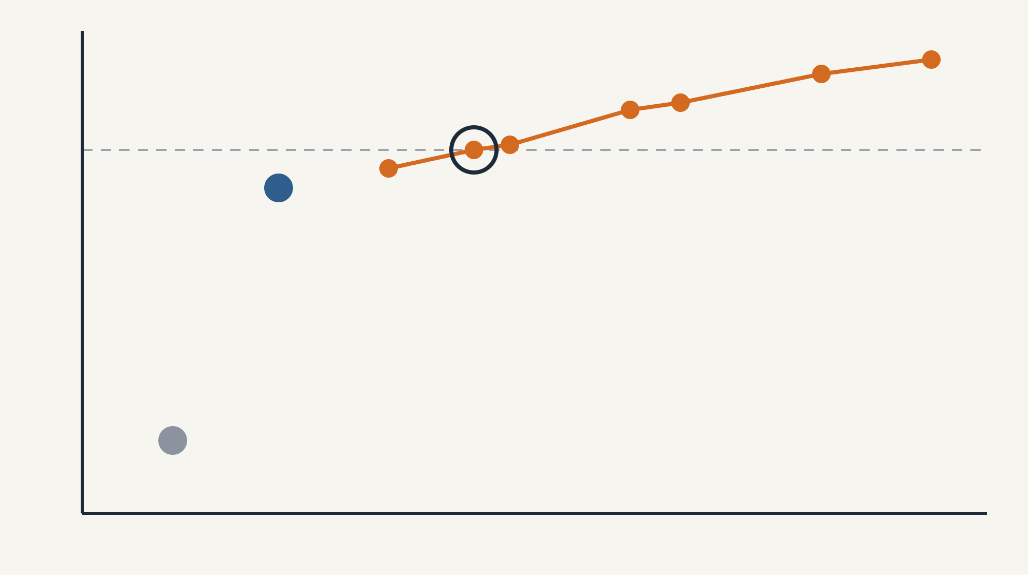
Choosing how safe to be
STEP 3 · HOW MUCH SHOULD WE KEEP?
Availability ↑
Each orange dot is one safety setting of the textbook formula, replayed on 2021.
Most safety: 95%
Further right = more money on the shelf. Higher = more demand served.
90%
Target 90%
Our choice: 90%
Course formula: 88%
Our rule: the cheapest setting that serves at least 90% of demand from the shelf.
80%
Chosen: 90% for very important, 85% for important, 80% for less important articles.
Today's reorder points: 74%
70%
2.0
2.5
3.0
Money on the shelf in the replay, million →
Notes:
This chart is how we chose the final setting. Every dot is one way of setting the safety buffer, tested in the 2021 replay. The horizontal axis shows how much money sits on the shelf; the vertical axis shows availability, the share of demand served from the shelf. The orange line connects seven settings of the textbook formula, from 'a bit of safety' on the left to 'a lot of safety' on the right. You can see the trade-off clearly: every extra point of availability costs more money, and it gets more expensive the higher you go. The grey dot is today's reorder points with disciplined ordering: only 74 percent. The blue dot is the course formula: 88 percent, and quite cheap. That is an honest finding: the simple course formula performs surprisingly well on average, because for the typical 30-day waiting time, one 'swing' of monthly demand happens to be about the right buffer. Its weakness is that it protects short-waiting articles too much and long-waiting articles too little. Our rule for choosing: take the cheapest setting that reaches at least 90 percent. That is the circled dot: 90 percent of demand served for very important articles, 85 percent for important, 80 percent for less important. Interesting detail: giving different targets by importance reaches the same 90 percent as a flat 90 percent target, with less money. Why the textbook formula, if the course formula is cheaper? Because the safety level becomes a clear dial that management can set. If 88 percent is good enough, the course formula is the cheaper option – and we say so openly.

Slide 16
One article tells the whole story
EXAMPLE
Article 1425485 · a production part needed every month · about 19,000 units per month · 20 days delivery time
 | Today | Recommended
Reorder point | 5,553 | 23,255
Demand while waiting for a delivery | ≈ 12,800 | ≈ 12,800
Average stock on the shelf | ≈ 100,000 units (5 months) | ≈ 20,000 units (1 month)
Availability in the 2021 replay | 64% | 93%
Money on the shelf | 100% | 20% (−80%)
The reorder point goes up, yet the money goes down by 80% – because we order one month at a time instead of filling the shelf for five months.
Notes:
If you remember one example, remember this one. Article 1425485 is the article with the most money on the shelf. It is a production part used every month, about 19,000 units per month, and the supplier needs 20 days to deliver. During those 20 days, production uses about 12,800 units. But the current reorder point is only 5,553 – less than half of that. So with disciplined ordering, it would regularly run out: in the replay only 64 percent of demand was served. Yet in reality the shelf held about 100,000 units on average – more than five months of demand – because the company ordered huge quantities at once. Our recommendation does two things. First, raise the reorder point to 23,255, so a new order is placed early enough. Second, order about one month of demand each time. Result: the average stock falls to about 20,000 units, the money on the shelf falls by 80 percent, and availability in the replay rises from 64 to 93 percent. This single article shows the whole project: the problem was never only the reorder point – it was ordering too much at once. Note: 'Money on the shelf 100 percent' just means today's level as the reference.

Slide 17
What it adds up to
RESULT
−55%
Measure | Articles | Money
New reorder points + sensible order sizes | 1,007 | −50%
Own-made finished products: make when ordered | 210 | −100%
Rare movers: order when a customer orders | 281 | −100%
No demand: stop reordering and sell off | 182 | −100%
money tied up in stock
(4.96 → 2.23 million disguised units)
74% → 90%
availability in the 2021 replay
Bonus: if suppliers accept smaller minimum orders, the total reaches about −63%. Savings arrive gradually, as today's stock is used or sold.
Notes:
Here is everything added up. The money tied up in stock falls by 55 percent, from 4.96 to 2.23 million disguised units – and at the same time availability in the 2021 replay rises from 74 to 90 percent. Where does it come from? The biggest part: the 1,007 articles that stay on the shelf. With the new reorder points and ordering about one month at a time, their money falls by half. The rest comes from the articles that leave the shelf: own-made finished products made when ordered, rare movers ordered when a customer orders, and articles without demand phased out. The 71 new articles we are watching are unchanged. Two cross-checks agree: the formula estimate for the stocked articles (2.18 million) and the day-by-day replay (2.38 million on the tested articles) are close. Bonus lever: for many articles, the supplier's minimum order is far larger than one month. If those minimums were renegotiated down to one month of demand, the total reduction would reach about 63 percent. Two honest caveats: the savings do not appear overnight – they appear as existing stock is used up or sold. And because the data are disguised, the percentages are what matter, not the absolute amounts.

Slide 18
What the client should do now
NEXT STEPS
Apply the four group rules
Order less at once
Negotiate smaller minimum orders
Keep only the groups that really need to be on the shelf.
When the reorder point is reached, order about one month of demand – no more bulk buying.
For 281 articles one order covers more than a year of demand.
Set the safety level consciously
Measure real delivery times
Talk to big customers
Today they are rounded guesses (30, 15, 10 days); 37 stock articles have none.
For irregular large orders, agree on advance notice instead of huge buffers.
90% / 85% / 80% by importance – a management decision, not a habit.
And: recalculate groups and reorder points every three months from the latest data.
Notes:
What should the client actually do on Monday morning? Seven things. One: apply the four group rules – keep production parts and bought-in sales articles on the shelf, make own products when ordered, order rare movers on demand, phase out articles without demand. Two, and most important: change ordering behaviour. When the reorder point is reached, order a defined amount, about one month of demand, and stop the precautionary bulk buying from the Covid period. That alone is the biggest lever, as the 57 percent showed. Three: renegotiate minimum order quantities, or use the second supplier – the case description says every article has at least two. For 281 articles one order covers more than a year. Four: decide the safety level consciously. Our chart shows exactly what each extra point of availability costs, so management can choose. Five: measure real delivery times from order and receipt dates. Today they look like rounded guesses, and 37 stock articles have none at all – but the formulas depend on them. Six: for customers who place big irregular orders, agree on advance notice or call-off orders, instead of holding a huge buffer just in case. Seven: repeat the whole calculation every three months, because demand changes.

Slide 19
What we should be honest about
HONESTY
Disguised data: prices and quantities are scaled – only percentages are meaningful.
Today's master data: we do not know past reorder points, and past stock is valued at today's prices.
Stock history glitch: day-to-day jumps in the stock levels – a second calculation gave the same conclusions.
Simplified replay: fixed order sizes and fixed delivery times – fair for comparing options, not a copy of reality.
“Normal” demand assumed: for very irregular articles the buffer formulas fit less well.
2021 still contains Covid effects.
Notes:
Every analysis has limits, and naming them makes the work more credible, not less. One: the data were disguised, so we only interpret relative numbers. Two: the article data such as price, reorder point and lead time are today's values copied onto every row. We therefore do not know how reorder points changed over time, and past stock is valued at today's prices. Three: the stock level jumps between days in about half the cases. We checked this with a second calculation, and the conclusions held. Four: the replay is a simplified model. It uses a fixed order size and fixed delivery times and treats missed demand as lost. That is fine for comparing options fairly, but it is not a perfect copy of what happened. Five: the buffer formulas assume that demand behaves 'normally' – symmetric around an average. For very irregular articles, with big customer orders now and then, that fits less well; that is why we recommend talking to those customers. Six: the test year 2021 still contains Covid effects. Natural next steps would be better forecasting for irregular demand, variable delivery times in the model, and validating everything with the original, undisguised data.

Slide 20
Cheat sheet: the story in five sentences
FOR THE CALL
The company stocked up during Covid; money in stock rose 41% from 2018 to 2021.
Most of that money sits in a few active articles – not in dead stock.
The real cause is ordering too much at once: 57% of the stock is not needed even by the company's own reorder points.
We sorted articles into four groups: keep production parts and bought-in articles; make own products when ordered; order rare movers on demand; phase out the rest.
New reorder points, tested on 2021: −55% money, availability from 74% to 90%.
Key numbers
Number | Meaning
1,751 | stock articles
10% → 74% | of articles hold of the money
57% | of stock beyond own rules
4 groups | 4 rules
−55% | money in stock
74% → 90% | availability
Notes:
Keep this slide open during the call. If your colleague remembers only one sentence, it should be: the company bought availability with money, and we show how to get better availability with about half the money. The five sentences on the left are the whole story in order: problem, where the money is, the real cause, the groups, the result. The numbers on the right are the ones most likely to come up in questions. Likely questions and short answers: Why 1,751 stock articles and not the roughly 3,600 in the course slides? Our data are a disguised version; we applied the course definition (safety stock above zero) to our data. Is 74 percent the real availability today? No – it is what today's reorder points would deliver with disciplined ordering; in reality the excess stock covered the gaps. Why the textbook formula if the course formula is cheaper? Because the safety level becomes an explicit management choice; if 88 percent is enough, the course formula is the cheaper option. Are 55 percent savings realistic? The direction is solid and two calculations agree, but the savings arrive gradually and require changing how much is ordered.

